Slide 1

GPS Data Sample for Tanzania by Quadrant
13 November 2025

Slide 2
Today
Background:
Data sample of one recent week
Check quality and usability
Purchase data? – 1 year of data for ~5000 USD
Goal of today:
What issues does the data have?
Which other checks should I do?
General feedback

Slide 3
Research Question
What is the impact of a new (green) transport technology on economic development & inequality?
Outcomes from this dataset:
1. Mobility Patterns: Visits away from home location
Frequency
Spatial extent
Locations visited (types of destination (train station, airport etc.), urban vs rural settlements)
2. Proxies for economic activity
Changes in inferred work location
Changes in activities around certain Points of Interests (e.g., markets)

Slide 4
Overview of Data Sample
Main variables:
device_id
timestamp
latitude & longitude
One week of data: 01.10.2025 - 08.10.2025
6 821 377 pings from 204 512 devices
High precision of pings: ~1m
Within the sample week:
Users appear on two different days on average
50% of people appear only on one day
Aggregate travel patterns rather than daily movements

Slide 5
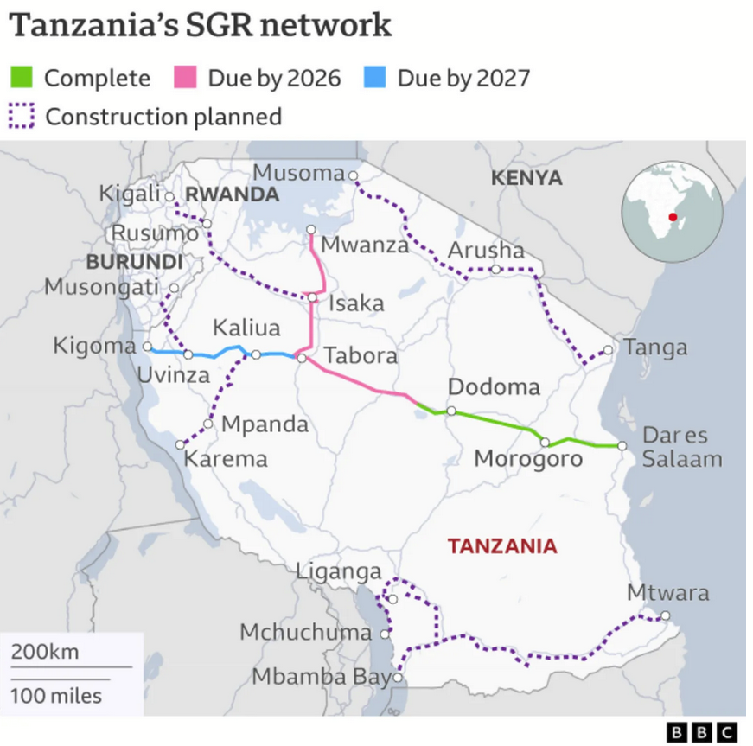
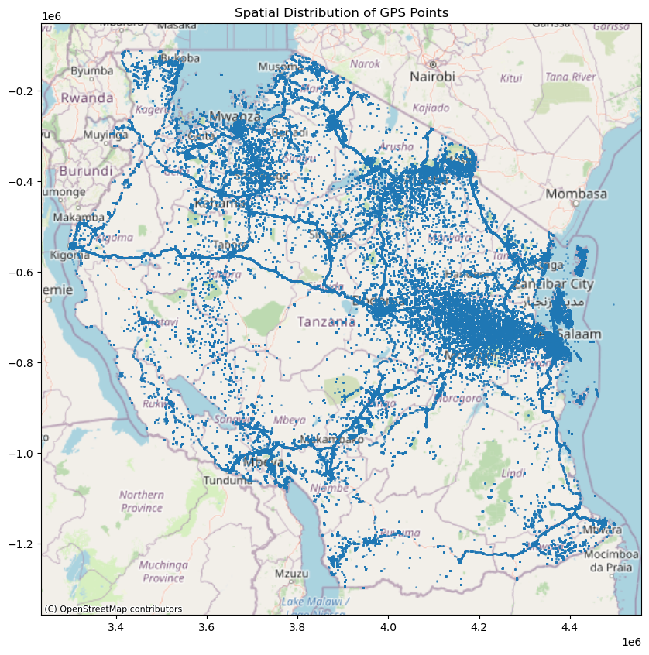
Spatial Coverage

Slide 6
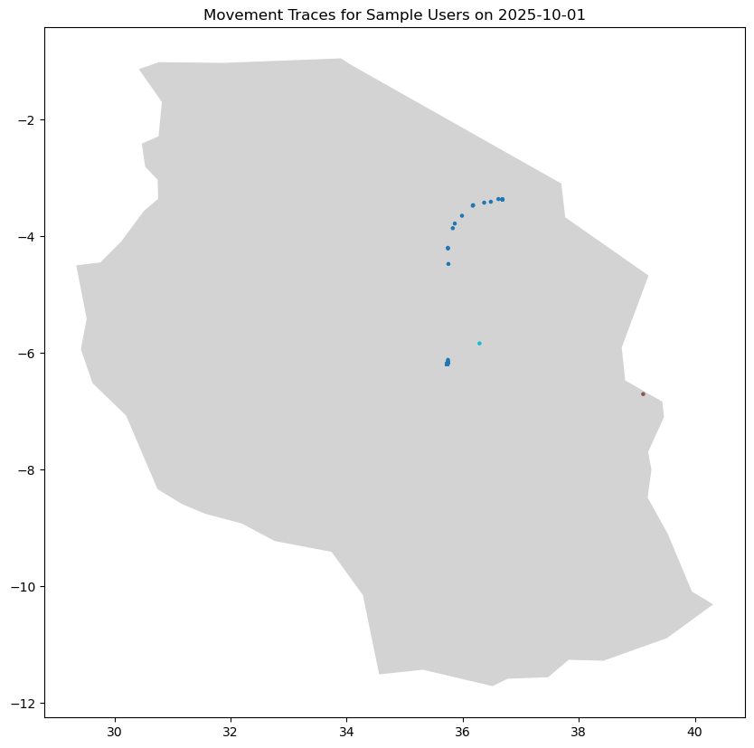
Example of GPS traces

Slide 7
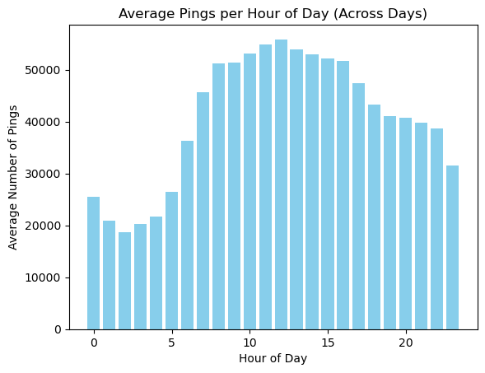
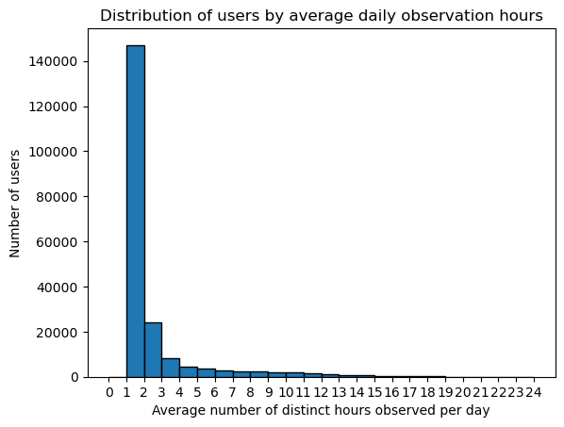
Temporal Coverage
Across all users: Pings at high frequency (less than a second between pings)
Per user: 1 hour between pings on average
Across the week: 33 pings per user on average
Per day: Users appear on average at 2 different hours (conditional on being seen that day)

Slide 8
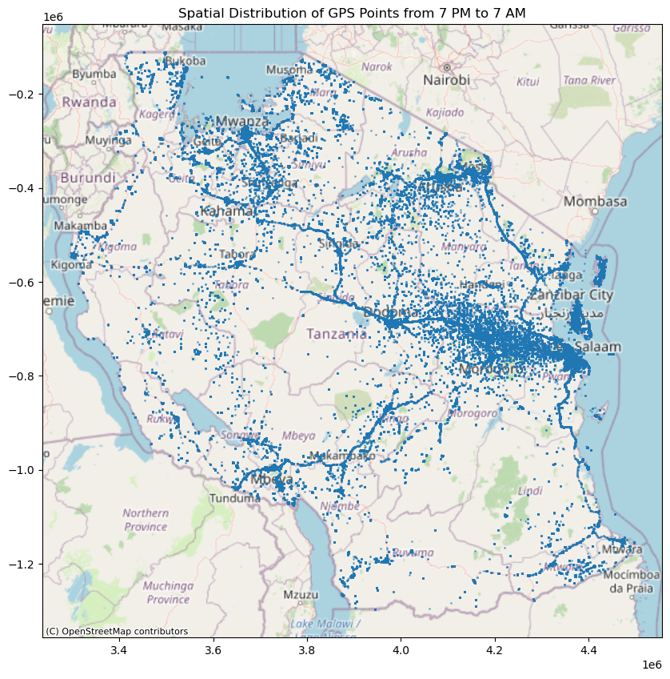
Identifying Home Locations
Define nighttime from 7 PM to 7 AM
55% of users are observed during nighttime at least once
Users are seen on 2 different nights on average
Out of all users who are observed for more than one night, 55% are seen in a consistent night location
Notes:
For comparison, in Blanchard et al. they only use people who show up for 10 nights and 50% in the same spot over night, and for 8 distinct weekdays at work and 50% of total weekdays at the same spot. For Tanzania, they have 237,123 (22,994) (high-confidence) users with 457 (2,132) pings over one entire year. For the big sample, they have a bit more than 1 ping per day (similar to this sample where I have 1.3 pings per user). In the high confidence sample, they have around 6 pings per day.

Slide 9
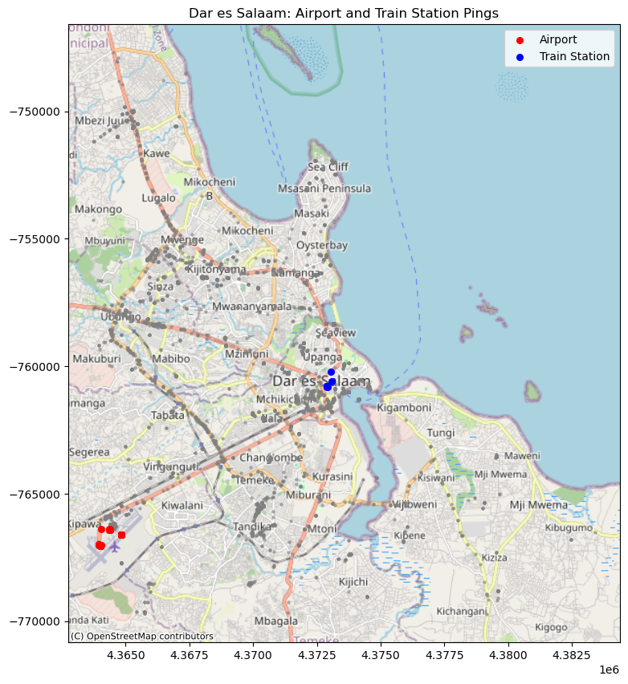
Trip reconstruction & mode detection
Can I detect travel patterns?
395 users were seen in Dodoma and Dar es Salaam in the same day
Can I infer the mode of transport?
Possibility to zoom in on airports, train station, etc.

Slide 10
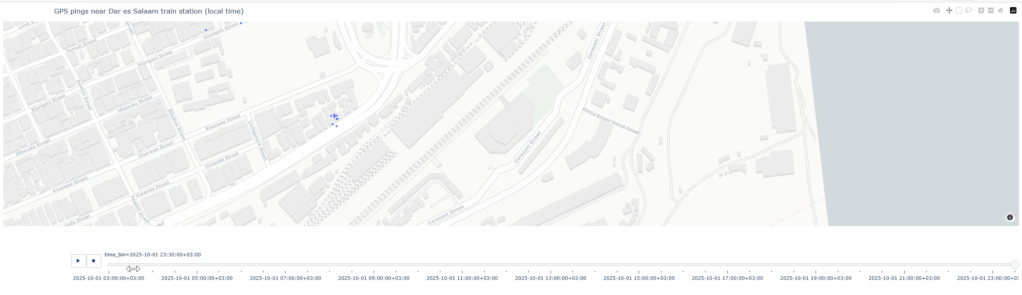

Slide 11
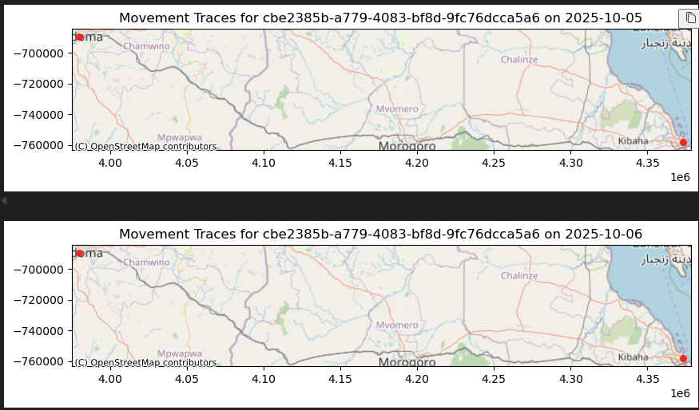
Irregularities of Data
Duplicated locations for the same user
37% duplicates in terms of location
27% duplicates in terms of location and device
89 983 (44%) users visit locations multiple times – mistake or not?
Unrealistic “travel times” between cities
185 out of 395 users “travelled” between Dar es Salaam and Dodoma in <1 hour – wrong timestamps?
Notes:
Could it be same accounts, same whatsapp etc. instead of same hardware device
timestamps

Slide 12
Limitations of Data
Highly selected sample – does not capture mobility patterns of poorest
No socio-economic variables
Infer home & work location
Merge with other data sources e.g., census data, population density data
Frequency of pings per user:
Hard to capture daily travel
Paper would rather address “visits” and aggregate travel patterns

Slide 13
Use Data to Measure:
1. Mobility Patterns (visits away from home)
Frequency
Spatial extent
Locations visited (different densities, types of destination (train station, airport etc.))
2. Proxies for economic activity
Changes in inferred work location
Changes in activities around certain Points of Interests (e.g., markets)
Heterogeneities by inferred income, density of home location
Research on "consumption trips" and how they are influenced by better transport connections

Slide 14
Blanchard et al. High-frequency human mobility in three African countries. (R&R Econometrica)
Summary:
Characterization of mobility in Tanzania, Kenya, Nigeria using GPS data
Concept of “consumption trips”: people visit locations away from their hometown to consume services
Develop economic model of consumption trips that shapes spatial patterns of development and welfare inequality
Intuition: Rural residents visit cities to consume services there – this impacts economic development both in cities and rural areas
Gap:
They do not take into account time cost of travelling & do not model trade-off between having access to a more vibrant service sector and the costs of reaching it
Research on the welfare consequences of mobility investments often focus on tradable goods – not so much on non-tradable services
Notes:
We show that the possibility of consumption trips creates winners and losers. Urban residents benefit because cities specialize in the production of services and “export” these to rural visitors and those from smaller cities.29 Within cities, the main beneficiaries are rich households, who spend a larger fraction of their income on services. Finally, and more surprisingly, we show that rural residents can actually be worse off once general equilibrium effects are taken into account: by taking their service spending to the city, they starve the local service sector of necessary demand.

